Slide 1
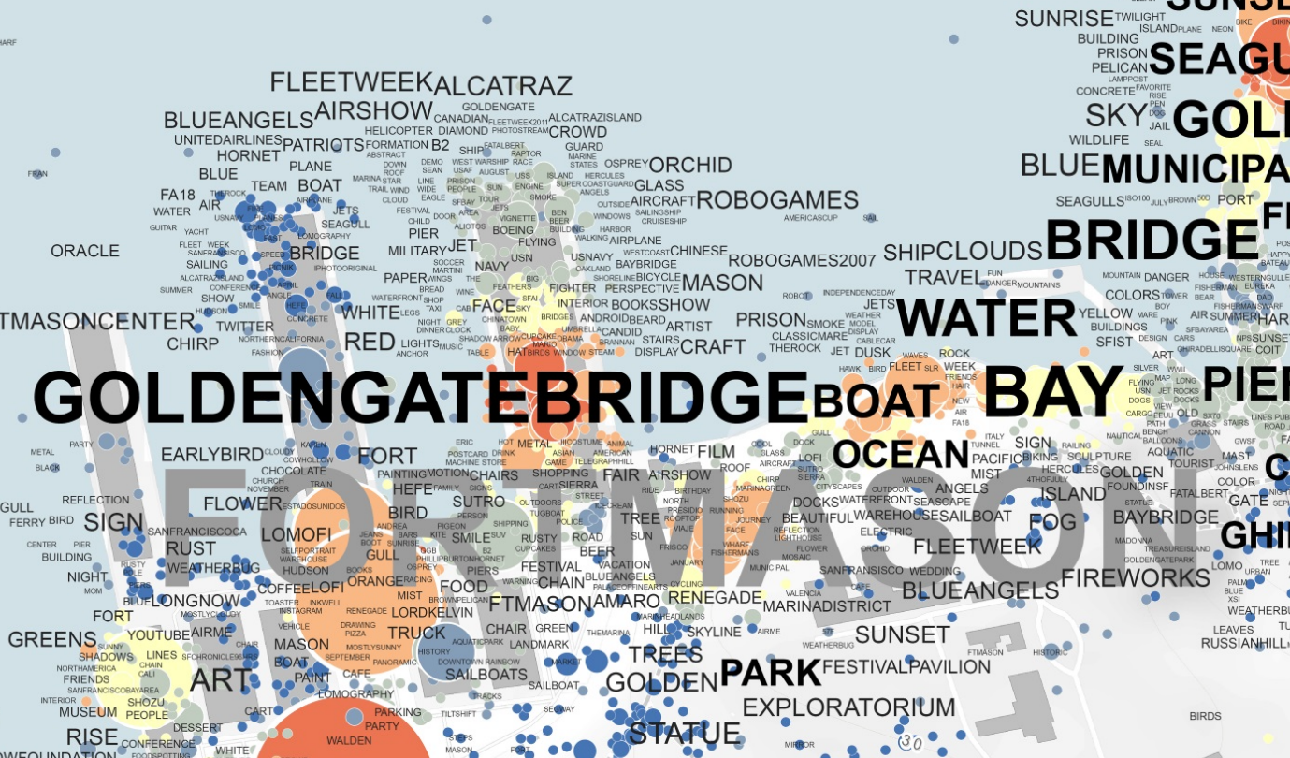
Workshop part 1: tag maps
Select Location of Analysis and export Photo Data
Cluster Photo Locations and Tag Data
Mapping and Symbolization

Slide 2
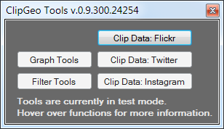
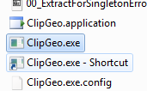

Data Selection
2
1
For clipping data from existing dataset
Open Clipping Tool <..\ 01_TOOLS\01STEP\ClipGeo.exe >
Open ClipData Tool (1)

Slide 3
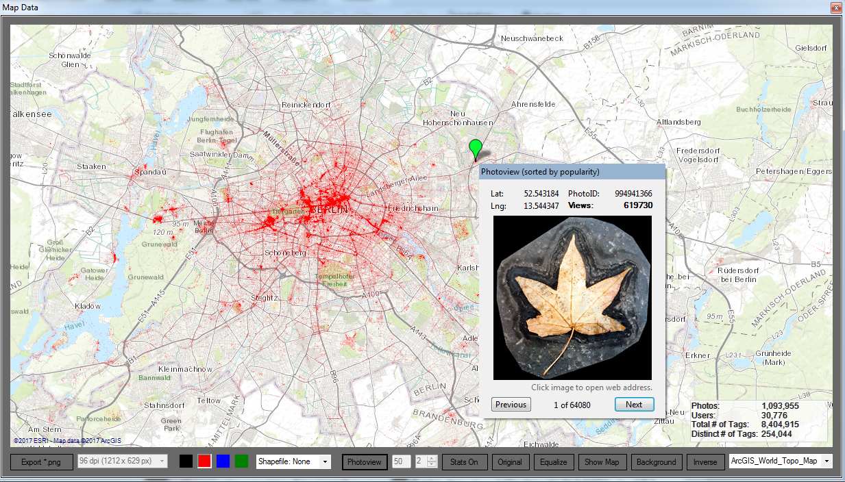
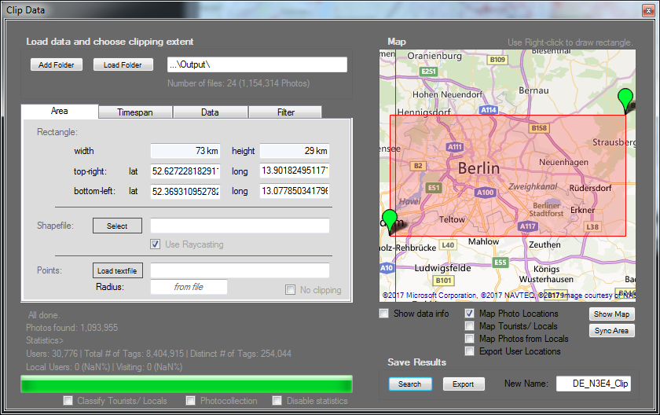

OPTIONAL: Generate Preview Map
1
3
2/4
5
For creating a preview map of photo locations
Load Folder <…\Input\> (1)
Click on ‘Show Map’ (2)
Select/zoom to visualization extent (3)
Click on ‘Sync Area’ (4)
Search (5) will generate preview map

Slide 4
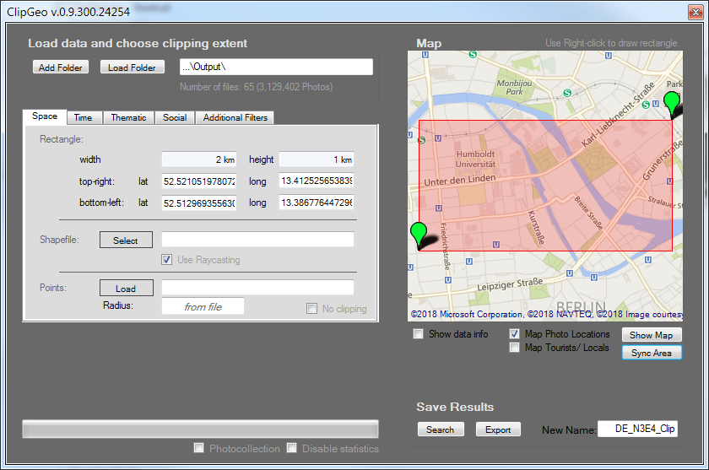

Data export
1
2 Name
3 Export
Load Folder <…\Output\> (1)
Provide a Name for Output (2)
Select Area
Export will save photo data to < …\Output\NAME\ > (3)

Slide 5
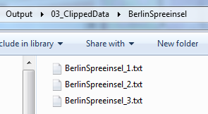
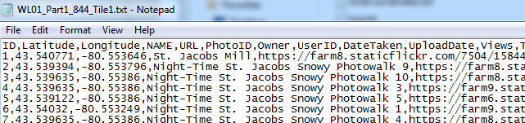
Copy Data
Output folder < … \ 01STEP_SelectPhotos_ClipGeo \Output\ 03_ClippedData \NAME\> contains clipped data files
Photos itself are not downloaded
Datafiles contain comma separated photo data (CSV)
Select all data files (1), copy (Ctrl+C)..
1

Slide 6
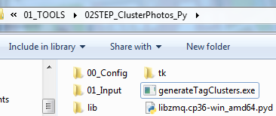
Cluster Photo Data
..and copy to folder < \ 02STEP…\01_Input\ > for clustering
Run generateTagClusters.exe
1

Slide 7
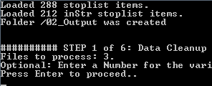
Optional: Tag Variety
Optionally provide a number for the variety of Tags to be processed (default is 1000 most used Tags)
Press enter to load Photo Data

Slide 8
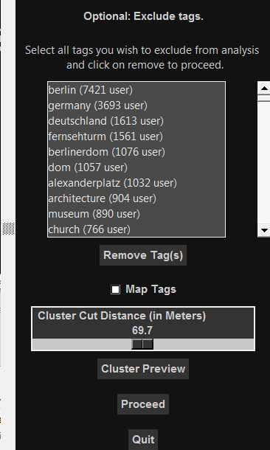
Modify Cluster Settings
Optional Cluster Settings
(1) Remove un- interesting Tags
(2) Create Preview Maps
(3) Modify Cut Distance (=Granularity of Tag Map)
(4) Create Cluster Preview
Afterwards: Click on proceed (5)
1
2
3
4
5

Slide 9
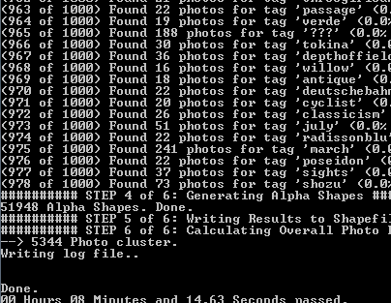
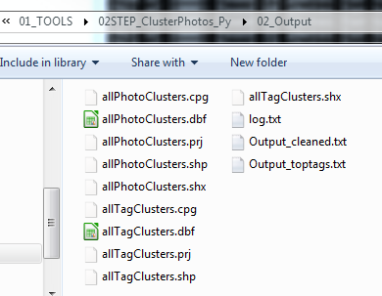
Review Output
2 Shapefiles are generated: allPhotoClusters.shp (Photo Location Clusters) allTagClusters.shp (Tag Clusters)

Slide 10
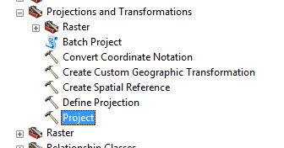
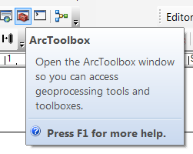
Project results
Open ArcGIS (BasemapLayout.mxd)
Open ArcToolbox (1)
Go to Data Management Tools/ Projections/ Project (2)
Project both output files to a suitable Projected Coordinate System

Slide 11
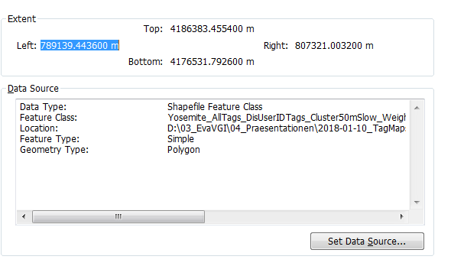
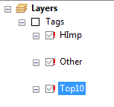
Map results
Use existing symbolization for Tags-Layers: Right Click First Layer > Properties > Data Source
Click Set Data Source and Choose projected Tag Cluster File from previous step
Repeat process for next two tag layers (use the same shapefile for all 3 Layers)

Slide 12
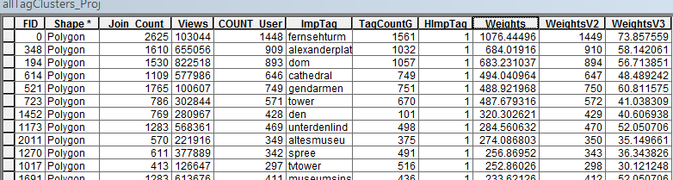
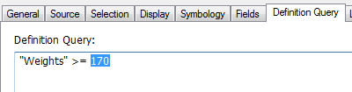
Adjust Definition Query
Tags are placed on the map in the following sequence: First, most used tags (largest font size) are placed in background Layer Top10: Weights >= x Second, each cluster with the most occurrences for each tag is placed: Layer HImP: Weights < x AND [HImP] = 1 Finally, all other tags are placed: Layer Other:[HImP] = 0
Edit Definition Query (Layer Preferences) to select the range of tags for each layer. Example: Definition Query "Weights" >= 20 for layer Top10, all labels with weights over 20 are placed in background.

Slide 13
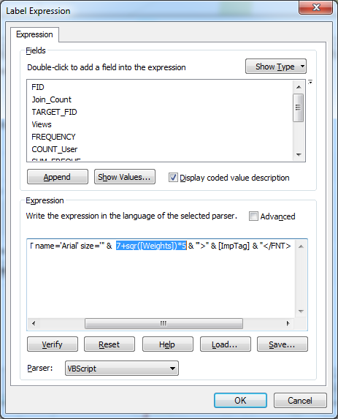
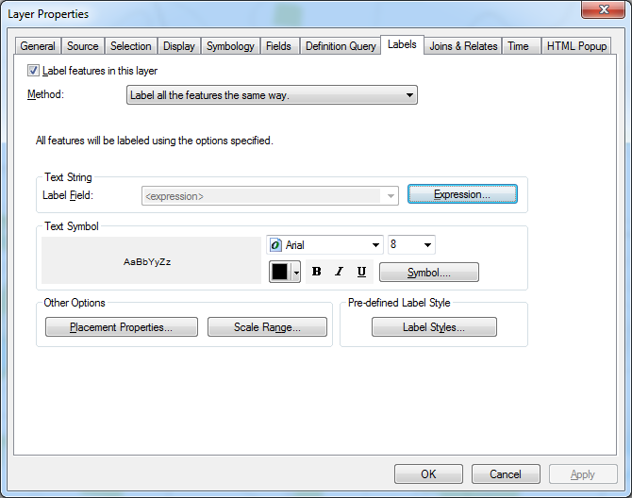
Adjust Font Size Modifier
The Font Size Modifier is used to adjust fonts to your final map display (Paper Size)
For each tag layer, go to … Layer Properties > Labels > Expression
Adjust Modifier: 7+sqr([Weights])*5 7 = Set minimum Font Size
Sqr = optional flattening of font size display curve * 5 = Set largest Font Size
Optional: Use [WeightsV2] or [WeightsV3] for different Weighting Formula (see next slide)

Slide 14
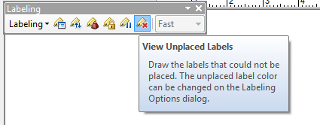
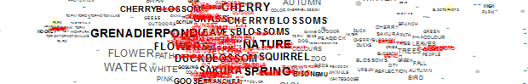
Verify Map
final map display depends on several criteria:
Use different Cluster Cut Distance if information resolution is too fuzzy, or too many duplicate clusters exist (Cut Distance too small)
Use different weighting formula, examples: 1+ [Join_Count] *(sqr(1/( [Join_Count] / [COUNT_User] )^3)) → Standard weighting formula 1+ [Join_Count] *(sqr(1/( [Join_Count] / [COUNT_User] )^2)) → less importance on User_Count in correlation to photo count [Join_Count] sqr(([Join_Count]+(2*sqr([Join_Count])))*2) → Ignores User_Count, this will emphasize individual and very active users
Use Right-Click > Labeling > “View Unplaced Labels” to verify tag placement, .. ..red labels are labels not placed on the map due to label density issues
Adjust Font Size Modifier if Fonts are too large or small, or placed too far off

Slide 15
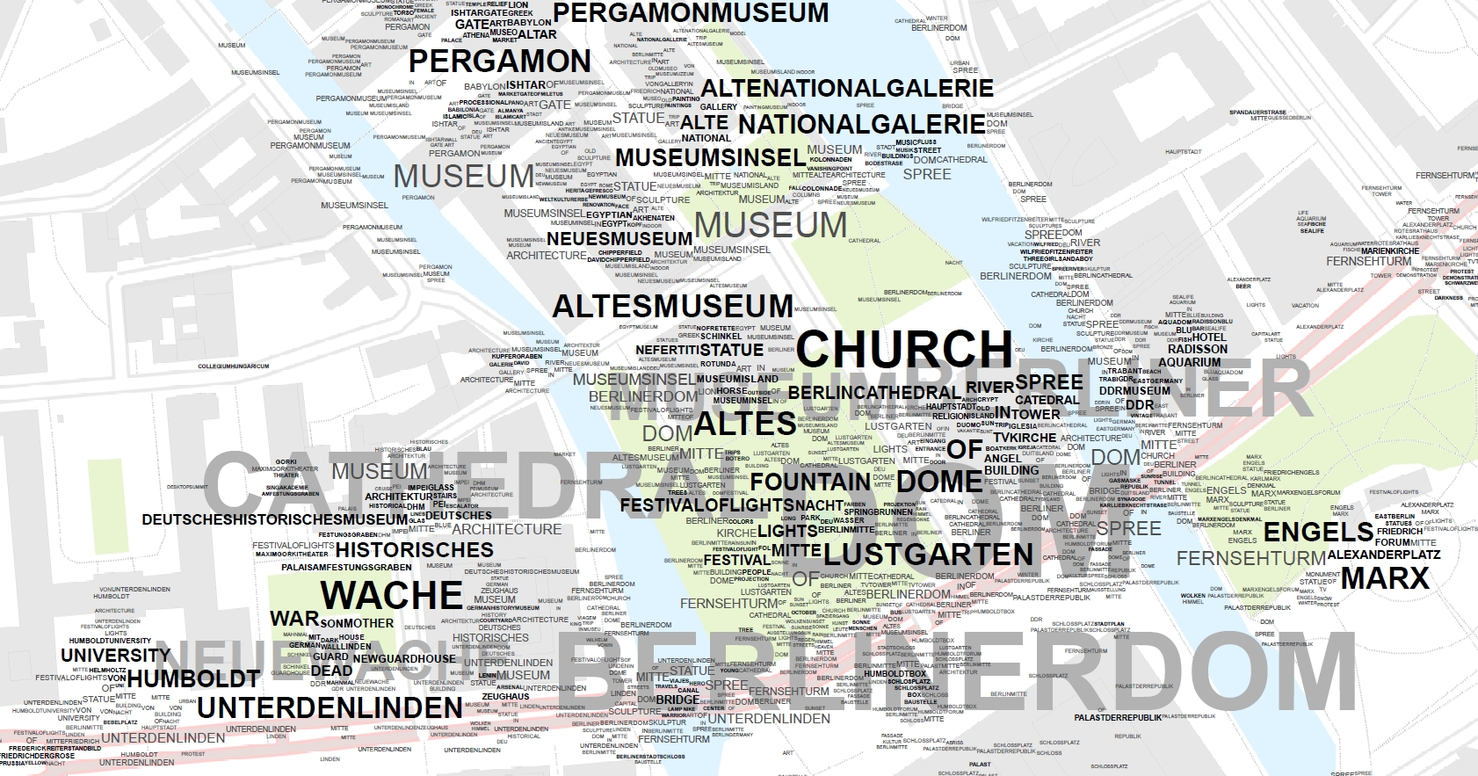
Add background as reference
> Goto Part 2 to add photo density layer
(02_PhotoDensityMaps.pptx)

